Slide 1


How Managed Operations helps your IT environment
An introduction to the ONDIT Managed operations portfolio

Slide 2
Agenda
Introduction to Ondit
Do more with less...
Datacenter Services
Managed Services
The Glue that holds everything together

Slide 3
Agenda
Introduction to Ondit
Do more with less...
Datacenter Services
Managed Services
The Glue that holds everything together

Slide 4
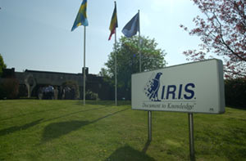
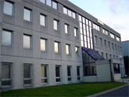
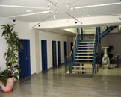
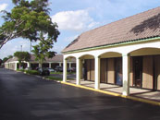
I.R.I.S Group
Founded in 1987
HQ in Belgium with international presence
Profitable since 1991
More than 600 employees
100+developers, growing R&D
World leader in imaging and recognition
IBM Benelux leader Infrastructure & Services
Core Activities :
  - High-speed Scanning and Data Capture
    from paper and electronic documents
    OCR, intelligent document reading, invoice reading
  - Secure Management & Sharing of information and records
  - Long Term Archiving and storage of digital records
  - Document Processing Outsourcing
  - ICT Infrastructure

Slide 5
I.R.I.S Group

Slide 6
Ondit?
Evolved from an Infrastructure & Services partner “on customer request”
Legal entity to consolidate I.R.IS. Managed Operations Group Wide
A 100% I.R.I.S ICT company
Dynamic : modular approach
Efficient : appropriate and adequate solution
Expert : > 20 years of technical experience

Slide 7
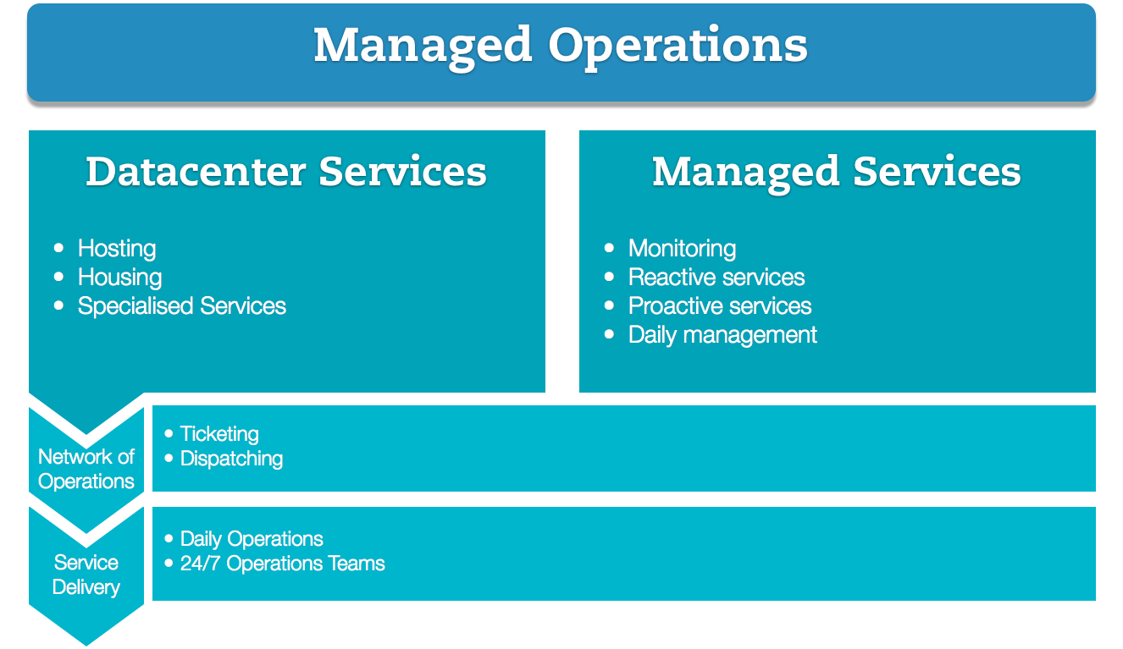
Ondit Structure

Slide 8
Agenda
Introduction to Ondit
Do more with less...
Datacenter Services
Managed Services
The Glue that holds everything together

Slide 9
Do more with less…
... While reducing your carbon footprint
But also with less:
Headaches
Stress
Overhead
Money

Slide 10
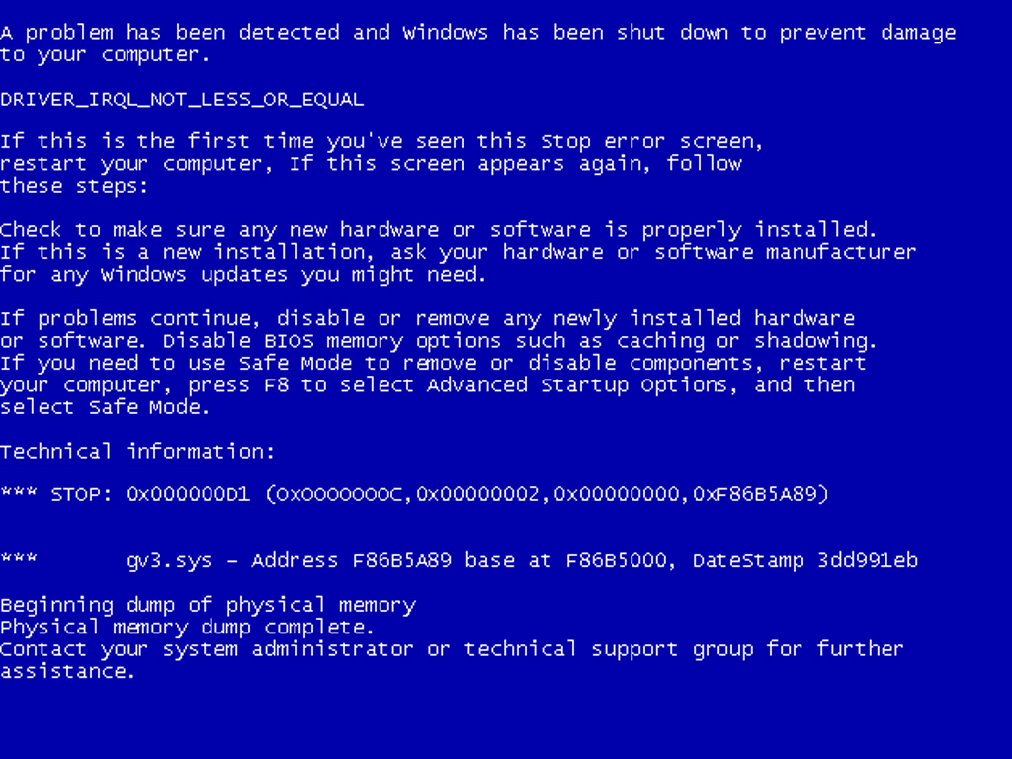



Headaches and stress caused by:
Application crash
Disaster
Hardware Failure
Need for additional manpower

Slide 11
Overhead and expenditure caused by:
The need for in-house expertise for every IT component/application/OS/...
(redundant) datacenter(s)
Fixed (non productive) capacity for disaster recovery
Less flexibility

Slide 12
But, with more:
Staffing and resource Flexibility
Focus on core activities
Efficiency
Expertise and skilled manpower
Productivity

Slide 13
For example…
Bring in additional manpower when you need them
Server/Storage/Network resources on demand
Correct level of disaster recovery for each application

Slide 14
How?
Ondit aims to provide tailored solutions to assist you in overcoming the ever-increasing challenges IT departments face, ranging from basic monitoring to complete out-tasking and outsourcing.
Thanks to our years of expertise in combination with our dynamic and efficient approach, Ondit offers a tailored solution for every client.

Slide 15
Ondit = 3 Keywords
Dynamic
Ondit, thanks to its modular approach, is an expert in the development and implementation of high technological solutions.
Efficient
Ondit offers the appropriate and adequate solution to every problem.
Expert
Ondit has over 20 years of technical experience, due to the working experience build up in the I.R.I.S. company.

Slide 16

Agenda
Introduction to Ondit
Do more with less...
Datacenter Services
Managed Services
The Glue that holds everything together

Slide 17
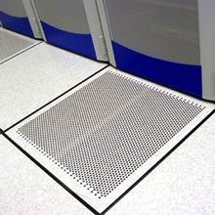
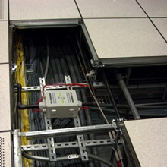
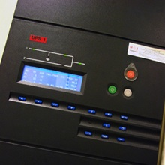
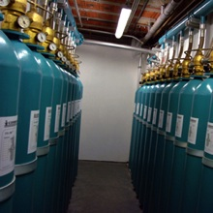
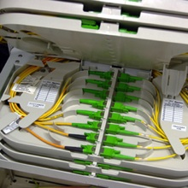
Datacenter services
Multiple Datacenters with each :
  multiple network carriers
  enterprise class power and backup power
  climate control and fire prevention/detection
  access security (physical and logical)

Slide 18
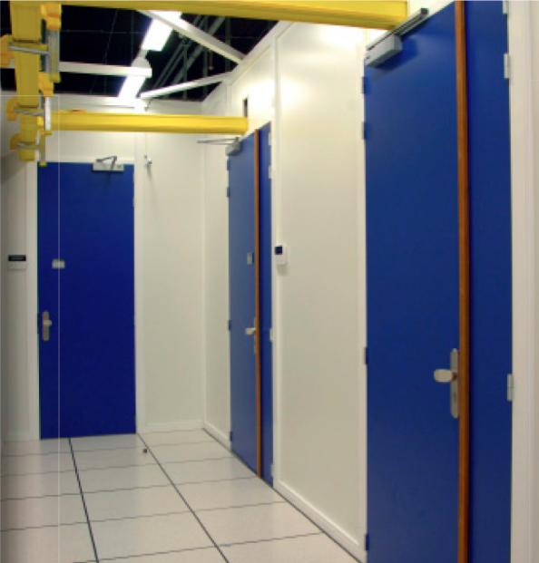
Value proposition
Eliminate the need for a dedicated computer room, air conditioning, backup power and redundant WAN connections by placing your equipment in one of our data centers.
This tailor-made rooms ensures us of the necessary capacity to house even high-end systems, and gives us the flexibility to design our network to the needs of our customers.

Slide 19
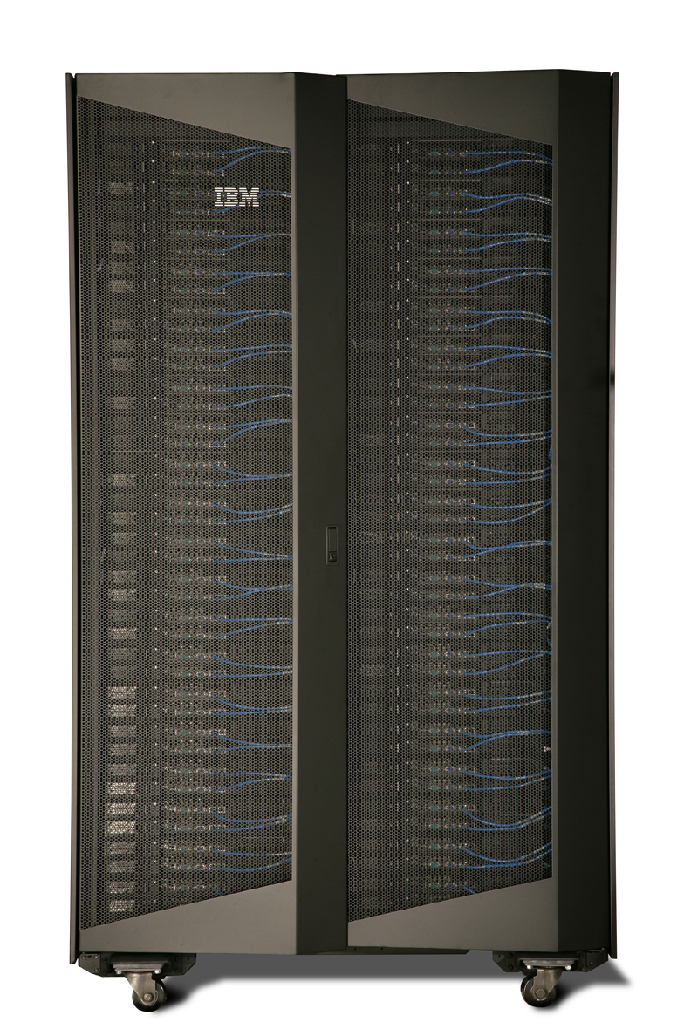
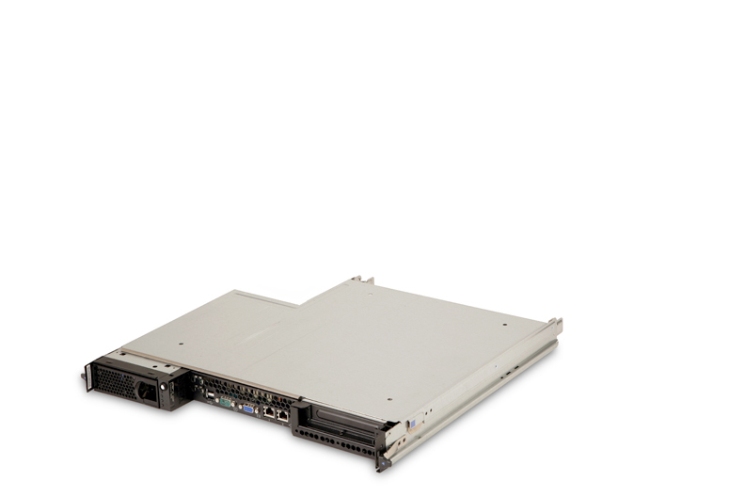
Housing
Rackspace - Host one or more devices in our shared racks
Full racks - Host your equipment in a dedicated rack
Private suites - Get your own dedicated room within our datacenter

Slide 20
Hosting
In addition to housing customer-owned hardware, we can provide the hardware for you.
This solution reduces your capital expenditures, and ensures your environment benefits from the economies of scale of our high-end environments.

Slide 21



Hosting ?
DAAS
SAAS
IAAS
PAAS

Slide 22



Going from a traditional approach…
Application need

Slide 23


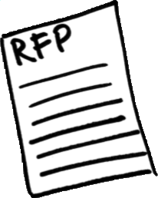



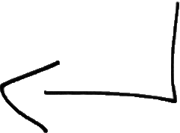
Traditional ordering: get prices, order, transport, installation.
Can take a lot of time.

Slide 24
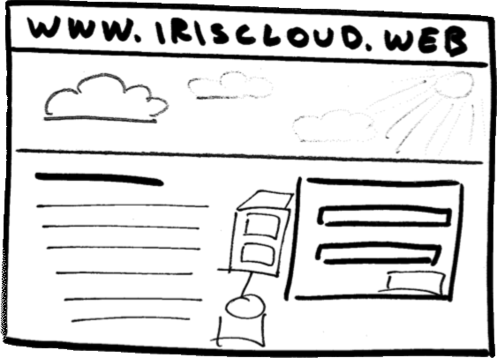
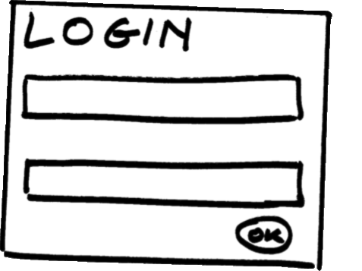
… to a “cloud” model!
With a self service portal (internal or external)
JeanCloudVanDamme
***************

Slide 25

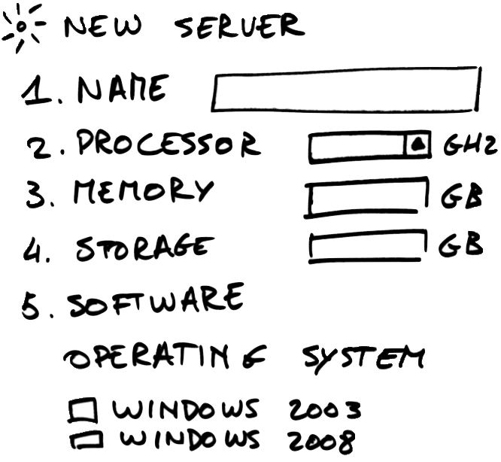
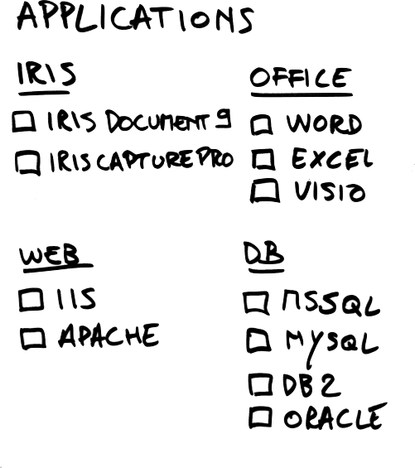
DocShare
✔
3
Software is automatically installed, and licensed correctly.
8
300
✔
✔
✔

Slide 26
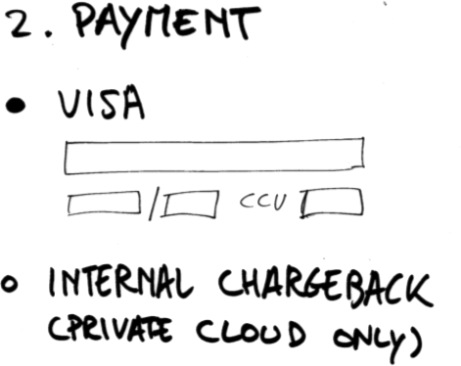

6504 5040 4365 0450
08
2015
666
Payment through credit card, or internal chargeback.

Slide 27


Result
User is up and running in minutes or hours, rather than days or weeks.

Slide 28
Ondit Hosting offering
Application hosting - We provide you with the necessary capacity to host your application, and scale up as necessary.
Dedicated virtual server hosting - Get your own dedicated virtual machine(s), with dedicated cpu, memory and disk capacity. Self-managed or managed.
Dedicated servers - Get your own full physical server, complete with administrator (root) access, at an attractive monthly cost

Slide 29







Long Distance Solutions
IP connectivity - Most of the Belgian and European carriers are present in our data center, ensuring short routes between your hosted equipment and your branch offices
Fiber optic links - We’re “on net” on major fibre optic networks like GlobalCrossing, Syntigo (B-Telecom) and Eurofiber. Our location in Antwerp is close enough to Brussels to allow for synchronous data replication, yet far enough to ensure regulatory compliance

Slide 30

Agenda
Introduction to Ondit
Do more with less...
Datacenter Services
Managed Services
The Glue that holds everything together

Slide 31
Managed Services
Monitoring
Proactive Services
“The Ondit Managed Services contract is based on standard building blocks or modules.
This makes it easy to provide a tailored solution to practically any needs!”
Reactive Services
Daily Management

Slide 32
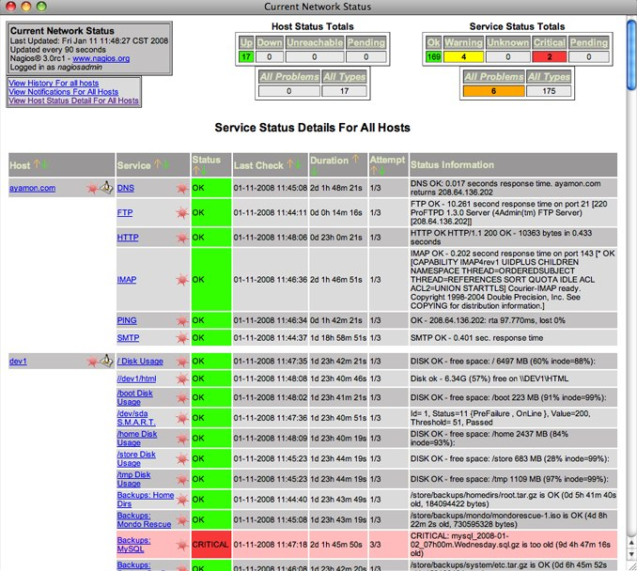


It all starts with the monitoring
Monitoring
Proactive Services
I.R.I.S. ICT Remote Monitoring appliance
  Open Source monitoring framework (Nagios)
  Custom build scripts/agents
Reactive Services
Daily Management

Slide 33
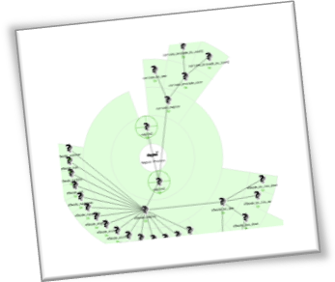
Monitoring with live reporting
Monitoring
Proactive Services
Reactive Services
Daily Management
Live view: monitoring web portal
Available on-demand, around the clock
Uptime, server performance and historic reports

Slide 34
Reactive Services
Monitoring
Proactive Services
24/7 standby services
SPOC for HW and SW vendors
Services on request
Reactive Services
Daily Management
Reactive services are designed to respond to requests for assistance (by phone, e-mail or through our ticketing solution), reports of incidents from our monitoring platform and/or as a result of viewing/analyzing monitoring logs and alerts.

Slide 35
Proactive Services
Monitoring
Proactive Services
Periodic health-checks and audits
Maintain OS levels and patches
Maintain microcode and firmware levels
Provide recommendations and best practice guidelines
Reactive Services
Daily Management
Our Proactive Services will keep your technology running smoothly and minimize losses due to technical failure as well as increasing uptime and productivity.

Slide 36
Daily Management
Monitoring
Proactive Services
Server management
User/groups management
Queue management
OS management
TSM/backup management
Network management
SAN checks/management
Perform upgrade tasks (minor only)/PTF updates,…
Reactive Services
Daily Management

Slide 37
Agenda
Introduction to Ondit
Do more with less...
Datacenter Services
Managed Services
The Glue that holds everything together

Slide 38
Our glue…
A team of skilled dynamic people
  Day-to-day management team
  24/7 support team
ITIL based Service Management portal
  Customer facing
  For ticketing, change requests and follow up
More than adequate resources at our carrier-neutral data centers

Slide 39

Thank You!
Marnix Vrambout
marnix.vrambout@iriscorporate.com
www.ondit.eu
@marnix

